Slide 1
Arrays of Greater Dimension
One-dimensional arrays are linear containers.
[0] [1] [2]
Multi-dimensional Arrays
[2]
[0] [1] [2] [3]
[1]
[0]
[0]
[0]
[1]
[1]
[2]
[2]
two-dimensional
[3]
[0] [1] [2] [3] [4]
three-dimensional

Slide 2
Initializing Multi-dimensional Arrays
declaration instantiation
[0] [1] [2]
Oval[] circles;
circles = new Oval[3];
[0] [1] [2] [3]
[0]
double[][] table;
table = new double[3][4];
[1]
[2]
[2]
[1]
[0]
[0]
int[][][] arr;
arr = new int[4][5][3];
[1]
[2]
[3]
[0] [1] [2] [3] [4]

Slide 3
How many cells in each of the following?
double[][] distance = new double[10][15];
int[][][] cube = new int[8][8][10];
String[][][][][] words = new String[5][4][5][12][6];

Slide 4
Creating Multi-dimensional Arrays
The initialization notation for 1D arrays can be extended.
char[][] words = { {'c', 'i', 'p', 'h', 'e', 'r'},
{'h', 'i', 'c', 'c’, 'u', 'p'},
{'a', 'p', 'i', 't', 'c', 'h'} };
[0] [1] [2] [3] [4] [5]
[0]
c
i
p
h
e
r
[1]
h
i
c
c
u
p
[2]
a
p
i
t
c
h
Exercise
How would you duplicate this behavior without the initialization notation?
© 2006 Pearson Addison-Wesley. All rights reserved

Slide 5
Processing Multi-dimensional Arrays
The key to processing all cells of a multi-dimensional array is nested loops.
for (int row=0; row!=5; row++) {
for (int col=0; col!=4; col++) {
System.out.println( myArray[row][col] );
}
}
[0] [1] [2] [3]
[0]
10
11
12
13
[1]
14
15
16
17
[2]
18
19
20
21
[3]
22
23
24
25
for (int col=0; col!=4; col++) {
for (int row=0; row!=5; row++) {
System.out.println( myArray[row][col] );
}
}
[4]
26
27
28
29
Exercises
1) Write a method to initialize this array with the given values.
2) Write a method to interchange two columns, indexed by two int parameters.

Slide 6
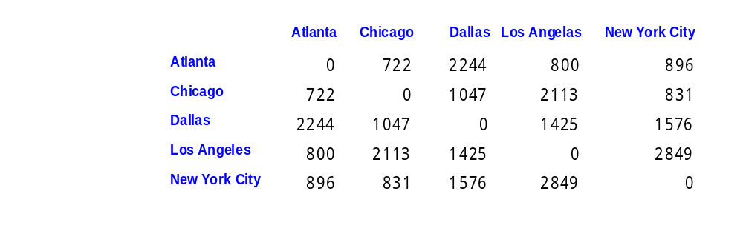
Tables
private final int[] mileage = {{0, 722, 2244, 800, 896},
{722, 0, 1047, 2113, 831},
{2244, 1047, 0, 1425, 1576},
{800, 2113, 1425, 0, 2849,
{896, 831, 1576, 2849, 0} };
private final int atlanta = 0;
private final int chicago = 1;
private final int dallas = 2;
private final int losAngelas = 3;
private final int newYork = 4;

Slide 7
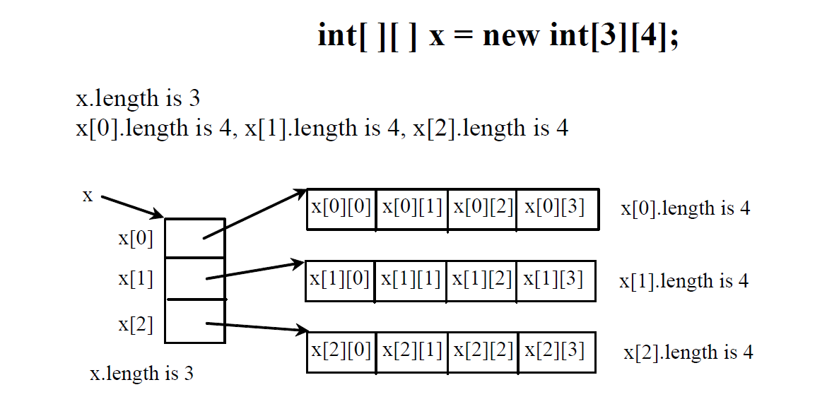
Obtaining the Length of a 2D Array

Slide 8
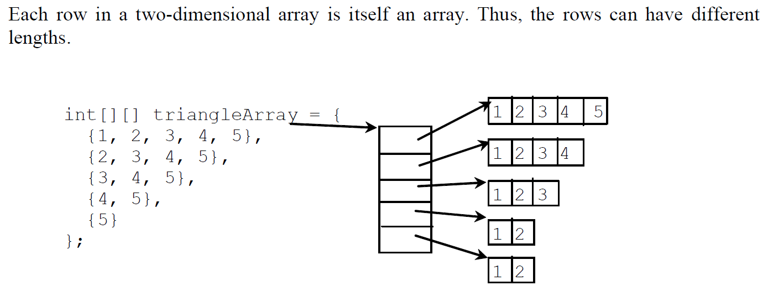
Ragged Arrays

Slide 9
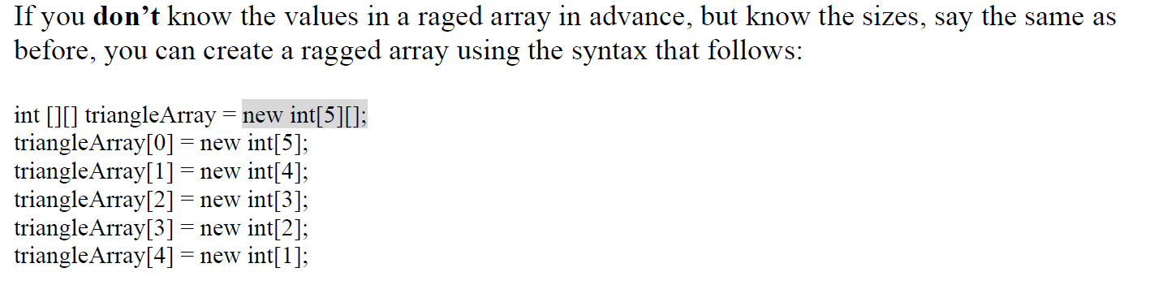
Ragged Arrays

Slide 10
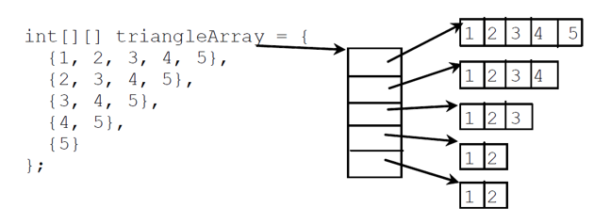
Ragged Arrays - Example
Declare a ragged array and initialise the array.
Sum all of the numbers in the ragged array.

Slide 11
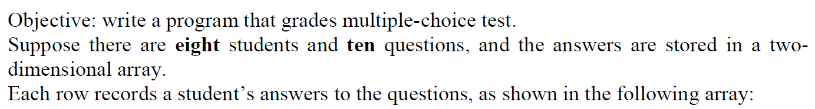
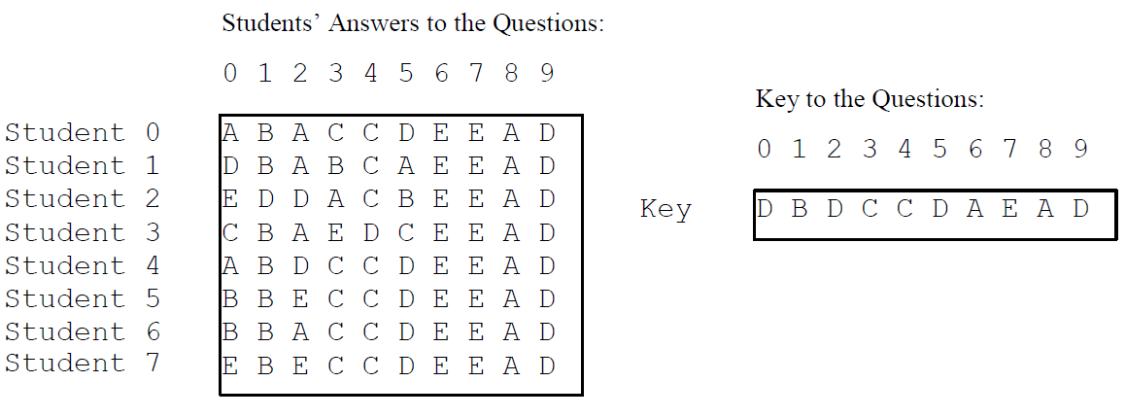
Grading a Multiple-Choice Test
12.5.<number>

Slide 12
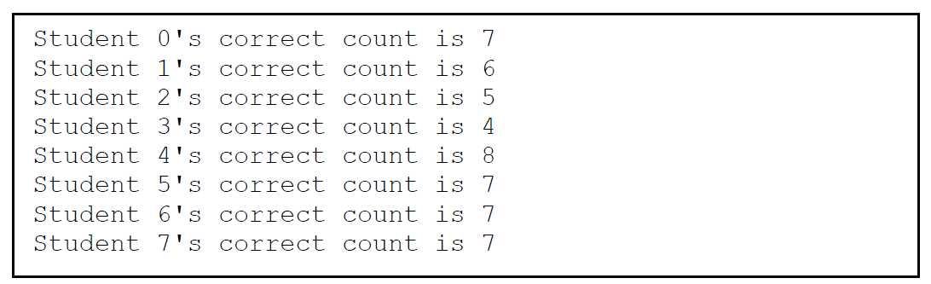
Grading a Multiple Choice Test

